Slide 1
Baseline Design & Results
SemEval 2023 - EDOS
Murali Manohar, Karlo Slot, Sanne Weering, Amber Chen

Slide 2
Pre-processing
Lowercase
Removal of non-words with regular expressions
URLs
Non-word characters
Non-alphanumeric characters
Interpunction
Tokenization
Lemmatization
Notes:
TODO: Examples for each step?

Slide 3
Dual Baseline Design
Most Frequent Classifier
Task A:
Not Sexist 0.757
Sexist 0.243
Task B:
Threats 0.091
Derogation 0.469
Animosity 0.342
Prejudiced discussion 0.099
SVM
N-grams → n=(1,2)
Term Frequency
TF-IDF

Slide 4
Data Splitting
70:15:15 train/dev/test split
No hyperparameter search → merge dev and test
85:15 train/test split (119,000 : 2,100 examples)

Slide 5
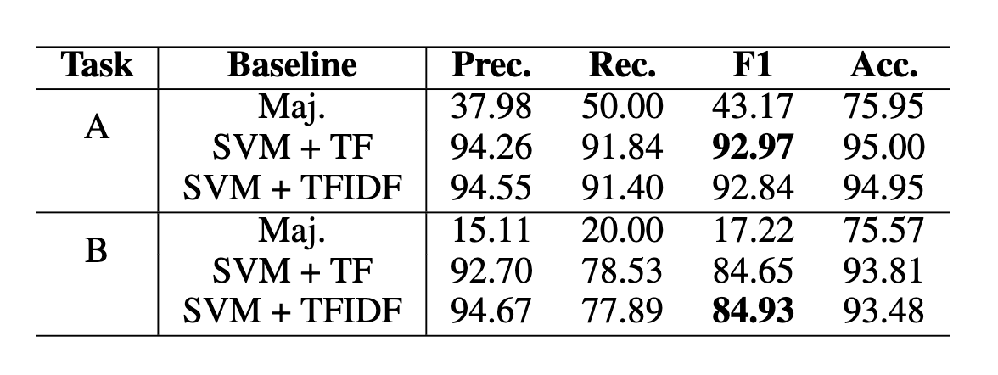

Slide 6
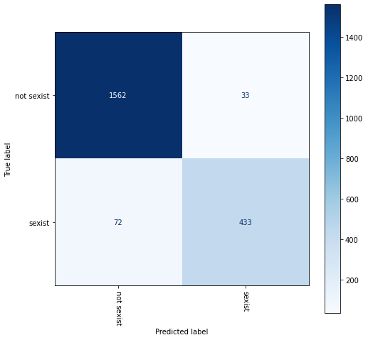

Slide 7
Error Analysis: Task A
Usage of slang:
['sexist', 'not sexist', 'them 52 femoids really want the 6 chad xd']
['not sexist', 'sexist','scandinavian cant be incel because theyre all chad']
Notes:
TODO: Add some examples

Slide 8
Confusion matrix Task B

Slide 9
Error Analysis: Task B

Slide 10
Top 10 Features for SVM: Task B
1. threats, plans to harm and incitement
['hang her', 'hang', 'as up', 'treasonous', 'lock her', 'treasonous off', 'shove', 'unemployed anyway', 'her unemployed', 'smack her']
2. derogation
['fat worthless', 'hate woman', 'witch she', 'bitch', 'witch', 'dislike female', 'are evil', 'slut', 'dislike', 'whore']
3. animosity
['cunt', 'bitch', 'pussy', 'thots', 'tranny', 'she tranny', 'thot', 'are easy', 'stupid old', 'typical woman']
4. prejudiced discussions
['woman right', 'take woman', 'woman suffrage', 'believe the', 'suffrage', 'right away', 'she divorce', 'rape him', 'suffrage wa', 'wa mistake']
none
['not men', 'up url', 'you hate', 'other woman', 'are not', 'for that', 'promiscuous', 'promiscuous woman', 'most men', 'and female']

